Slide 1
Memory Interfacing

Slide 2
Physical organization of memory and memory addressing
Each memory location can store one byte of data
The 8086 is a 16-bit microprocessor, it can transfer 16-bit data
This is stored by using 2 consecutive memory locations ,one for least significant byte and one for most significant byte

Slide 3
To implement this entire memory is divided into 2 memory banks
The address space is physically connected to a 16-bit data bus by dividing the address space into two 8-bit banks of up to 512K bytes each
One bank is connected to the lower half of the 16-bit data bus (D0 – D7) and contains even address bytes. i.e., when A0 bit is low(0), the bank is selected. so it is referred as even addressed bank.

Slide 4
The other bank is connected to the upper half of the data bus (D8 - D15) and contains odd address bytes. i.e., when A0 is high(1) and BHE (Bus High Enable) is low(0), the odd bank is selected. so it is referred as odd addressed bank.
A specific byte within each bank is selected by address lines A1-A19

Slide 6
Data can be accessed from the memory in four different ways
8 - bit data from Lower (Even) address Bank
8 - bit data from Higher (Odd) address Bank
16 - bit data starting from Even Address
16 - bit data starting from Odd Address

Slide 7
8-bit data from Even address Bank

Slide 8
To access memory bytes from Even address, information is transferred over the lower half of the data bus (D0 - D7)
The A0 is output LOW(0) and BHE is output HIGH(1) enabling only the even address bank

Slide 9
8-bit Data from Odd Address Bank

Slide 10
To access memory byte from an odd address information, is transferred over the higher half of the data bus (D8 - D15)
The BHE output low(0) enables the upper memory bank(ODD)
A0 is output high(1) to disable the lower memory bank (EVEN)

Slide 11
16-bit Data Access starting from Even - Address

Slide 12
16-bit data from an even address is accessed in a single bus cycle
Address lines A1 - A19 select the appropriate byte within each bank
A0 low and BHE low enables both banks simultaneously

Slide 13
16-bit Data Access starting from Odd Address

Slide 14
A 16-bits word located at an odd address (two consecutive bytes with the least significant byte at an odd byte address) is accessed using two bus cycles
During the first bus cycle the lower byte (with the odd address 0005 as shown in fig. in previous slide) is accessed
During the second bus cycle, the upper byte (with the even address 0006H as in fig. in previous slide) is accessed

Slide 15
During the first bus cycle, A1 - A19 address bus specifies the address and A0 is 1 and BHE is 0
Therefore the even memory bank is disabled and odd memory bank is enabled
During the second bus cycle, the address is incremented
Therefore A0 is 0 and BHE is made 1
The even memory bank is enabled and the odd memory bank is disabled

Slide 16
Operation | BHE | A₀ | Data Lines Used
Read/Write a byte at an even address | 1 | 0 | D7 – D0
Read/Write a byte at an odd address | 0 | 1 | D15 – D8
Read/Write a word at an even address | 0 | 0 | D15 – D0
Read/Write a word at an odd address | 0 1 | 1 0 | D15 – D8 in first operation byte from odd bank is transferred D7 – D0 in first operation byte from odd bank is transferred

Slide 17
General procedure of static memory interfacing with 8086:
Arrange the available memory chips so as to obtain 16-bit data bus width.
The upper 8 bit bank is called odd bank and lower 8 bit bank is called even bank
Connect available address lines of memory chips with those of the microprocessor
Connect the memory RD and WR inputs to the corresponding processor control signals
Connect 16 bit data bus with that of the microprocessor 8086

Slide 18
The remaining address lines of the microprocessor, BHE and A₀ are used for decoding the required chip select signals for the odd and even memory banks
The CS of memory is derived from the O/P of the decoding circuit

Slide 19
Interface 512KB RAM with 8086
Divide memory into odd/even address bank
Connect RD,WR of 8086 to RD,WR of RAM
If A₀ is low(0), BHE is high(1) then Even bank is selected. That is data lines are D₀-D₇
If A₀ is high(1),BHE is low(0) then Odd bank is selected. That is data lines are D₈-D₁₅

Slide 20
8086 CPU has 20 address lines (00000h to FFFFFh)
RAM is of 512KB (1KB=1024 bytes=2¹⁰ bytes)
Divide 512KB RAM into even and odd memory banks that is 512KB/2=256KB
Each bank is of 256KBytes
=256x2¹⁰ bytes
=2⁸x2¹⁰bytes=2¹⁸ bytes
18 address lines required to address memory location

Slide 21
Address map…
Address | A₁₉ | A₁₈ | A₁₇ | A₁₆ | A₁₅ | A₁₄ | A₁₃ | A₁₂ | A₁₁ | A₁₀ | A₉ | A₈ | A₇ | A₆ | A₅ | A₄ | A₃ | A₂ | A₁ | A₀
80000h | 1 | 0 | 0 | 0 | 0 | 0 | 0 | 0 | 0 | 0 | 0 | 0 | 0 | 0 | 0 | 0 | 0 | 0 | 0 | 0
RAM 1 AND 2 512KB: RAM1(256KB) RAM2(256KB)
: : :
FFFFFh | 1 | 1 | 1 | 1 | 1 | 1 | 1 | 1 | 1 | 1 | 1 | 1 | 1 | 1 | 1 | 1 | 1 | 1 | 1 | 1

Slide 22
Interfacing
8086 CPU
CS₁
CS₂
A₁-A₁₈
A₀-A₁₇
256KB RAM
(Odd Bank)
A₀-A₁₇
256KB RAM
(Even Bank)
RD
RD
RD
WR
WR
WR
D₁₅-D₈
D₀-D₇

Slide 23
Memory Chip selection
A₁₉
C
Input
Output
C = A₁₉
C | BHE | A₀ | CS₁ | CS₂
0 | 0 | 0 | 0 | 0
0 | 0 | 1 | 0 | 1
0 | 1 | 0 | 1 | 0
0 | 1 | 1 | 1 | 1
BHE
CS₁
ODD BANK
C
EVEN BANK
CS₂
A₀
CS₁=C + BHE
CS₂=C + A₀

Slide 24
80386DX and 80486(32-bit) Memory interface
80386DX and 80486 have 32-bit data buses and therefore 4 banks of memory
32-bit, 16-bit and 8-bit transfers are accomplished by different combinations of the bank selection signals BE3, BE2, BE1, BE0.
The Address bits A0 and A1 are used within the microprocessor to generate these signals

Slide 25
Memory interface of 1GB RAM to 80386DX
80386DX CPU has 32 address lines: A₀ to A₃₁ (00000000h to FFFFFFFFh)
RAM is of 1GB (IGB=1024MB and IMB=1024 KB)
Divide 1GB RAM into 4 memory banks that is 1GB/4=256MB
Each bank is of 256KBytes
=256x2¹⁰ X2¹⁰ bytes
=2⁸x2¹⁰ X 2¹⁰ bytes=2²⁸ bytes
28 address lines required to address memory location

Slide 26
Address map…
Address: C0000000h to FFFFFFFFh
Address lines A₀ to A₂₇ of Memory are connected to address lines A₂ to A₂₉ of processor

Slide 27
Interfacing
80386DX
A₂-A₂₉
A₀-A₂₇
A₀-A₂₇
A₀-A₂₇
A₀-A₂₇
256MB RAM
(BANK3)
256MB RAM
(BANK2)
256MB RAM
(BANK1)
256MB RAM
(BANK0)
E₃
E₂
E₁
E₀
BE₀-BE₃
A₃₀-A₃₁
D₂₄-D₃₁
D₁₆-D₂₃
D₈-D₁₅
D₀-D₇

Slide 28
Memory Chip selection
E₀=C + BE₀
A₃₀
C
E₁=C + BE₁
A₃₁
E₂=C + BE₂
C = A₃₀ . A₃₁
E₃=C + BE₃
BE₀
E₀
BE₂
C
E₂
C
BE₁
E₁
BE₃
C
E₃
C

Slide 29
64 – bit processor memory interface
The Pentium, Pentium Pro, Pentium II and III contain a 64-bit data bus.
Therefore, 8 decoders or 8 write strobes are needed as well as 8 memory banks.
A₀,A₁ and A₂ lines of processor are used for bank selection : BE7, BE6, BE5, BE4, BE3, BE2, BE1, BE0.

Slide 30
Generation of Write Strobes
The write strobes are obtained by combining the bank enable signals (BEx) with the MWTC signal
MWTC(memory write command) is generated by combining the M/IO and W/R signals

Slide 31
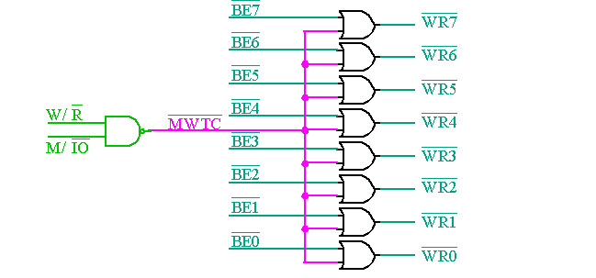

Slide 32
Memory interface of 512KB RAM to 64 bit processor(Pentium)
Pentium CPU has 32 address lines: A₀ to A₃₁ (00000000h to FFFFFFFFh)
RAM is of 512KB (IKB=1024B)
Divide 512KB RAM into 8 memory banks that is
512KB /8=64KB
Each bank is of 64KBytes
=64x2¹⁰ bytes
=2⁶x2¹⁰ bytes=2¹⁶ bytes
16 address lines required to address memory location

Slide 33
Address map…
Address: FFF80000H – FFFFFFFFH
Address lines A₀ to A₁₅ of Memory are connected to address lines A₃ to A₁₈ of processor
A₀,A₁ and A₂ lines of processor are used for bank selection : BE7, BE6, BE5, BE4, BE3, BE2, BE1, BE0.

Slide 34
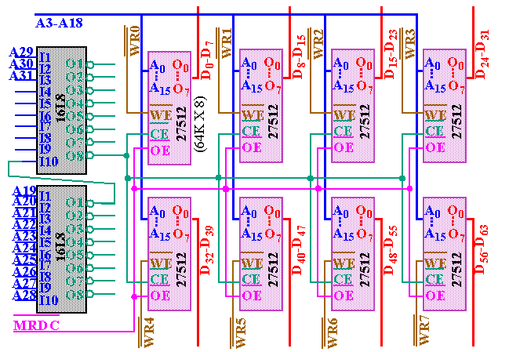
Pentium Memory Interface

Slide 35
16L8 is a memory address decoder with 10 fixed inputs(I₁ to I₁₀) , two fixed outputs(O₁,O₈)
Address lines A₁₉ to A₃₁ are given as input to 16L8 decoder
U₂ =A₁₉….A₂₈
CE= U₂ A₂₉ A₃₀ A₃₁

Slide 36
The decoder output is given to memory bank enable signal(chip enable(CE))
OE(output enable) of all memory banks is connected to MRDC(memory read command)

Slide 37
